Slide 1

Customer Satisfaction Through Market Basket Analysis
MINOR 1

Slide 2
Team
Faculty Mentor
Dr Hitesh Kumar Sharma
Members
Utkarsh Sandeep Singh
Adesh Kumar Gupta
Shankey Gupta
Tushar Singh

Slide 3
Abstract
A data mining approach used in markets like super markets are targeting more customers by using Market Basket Analysis using Apriori Algorithm.
This in turn will help in reducing the efforts of the customers by overcoming the problem of increased lookouts for other products.
We will be using this technique of Data Mining to overcome the challenges of most of the business of marts and retailers.
As more population results in more production of consumer goods as well as leading to more retailers and businesses.
With all these, the major issue is high competition among business organizations.

Slide 4
INTRODUCTION
In today’s generation many marts and wholesalers are competing with each other to provide more and more satisfaction to their customers. As the needs of the customers are being fulfilled by the retailers and managers with less efforts, it creates a chance of shopping more different products by the customer.
To understand how to analyze this pattern we will be implementing a Data Mining technique called MARKET BASKET ANALYSIS with the help of Apriori Algorithm.
Through this technique we are able to understand how the products are arranged in a mall , store, or a shopping complex such that less efforts of the customer will result them in purchasing most of the products of their needs even if they didn’t planned to buy it.

Slide 5
Example
Let’s take a basic example of milk. If a customer goes to a store to buy a packet of milk, and if the store manager puts some more products like Bread, Butter or Eggs along with it then there is high probability that the customer may buy any of these products too along with Milk even if they haven’t planned for it, as the products have a close association with each other.
To understand this and how it works we will be implementing Market Basket Analysis to analyze the pattern .

Slide 6
Problem Statement
Nowadays people buy daily goods from super market and marts. The problem which many retailers face is the arrangement of items in their store. They don’t know what item should be put at what place in their store so that all the associated products are available nearly.

Slide 7
Literature Review
Today, the large amount of data [1] is being maintained in the databases in various fields, like retail markets, banking sector, medical field etc. But it is not necessary that the whole information is useful for the user.
That is why, it is very important to extract the useful information from large amount of data. This process of extracting useful data is known as data mining or A Knowledge Discovery and Data (KDD) Process.
Frequent itemset mining [2] leads to the discovery of associations and correlations among items in large transactional or relational datasets.
Data Mining [3] provides a lot of opportunities in the market sector. Decision making and understanding the behaviour of the customer has become vital and challenging problem for the organization in order to sustain in this competitive environment.
Apriori Algorithm is [4] also called level-wise algorithm. It was proposed by Agrawal and Srikantn 1994.

Slide 8
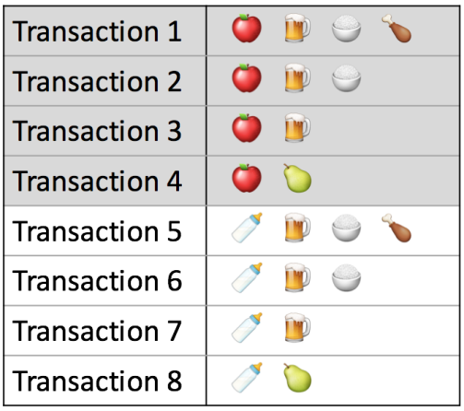



Support: A support is a parameter which is used in Apriori Algorithm to determine how frequent the item or group of items appear in the dataset.
Confidence: Confidence indicates the number of times the if/then statements have been found to be true.
Support
Support (A→B) = P(A,B)
Confidence
Confidence (A→B) = P(B/A) = Support(A→B)/Support(A)
=

Slide 9
OBJECTIVES
For Customer
This technique will be very useful for customers as very less efforts will be applied by them to get their desired products and will also help them to get the products of their needs for which they might not have already planned.
For Retailer
For Retailer the technique will be useful as it will result in increased sales of products if the products that are closely associated are kept together. This will result in more profit and challenge other shopkeepers in the market.

Slide 10
METHODOLOGY
Theory:
Market Basket Analysis is a technique which works on the principle that if a customer
buys a product, he is more likely to buy some more specific set of products along with
it.
For the implementation of this technique, we are need to have some sort of
requirements:
1- DATASET:
From Market (Real Time Data)
2- ALGORITHM:
Apriori Algorithm

Slide 11
Apriori Algorithm
By applying Apriori Algorithm onto a dataset, we will be having 2 factors:
1- Support:
A support is a parameter which is used in Apriori Algorithm to determine how frequent the item appears in dataset.
2- Confidence:
Confidence is also a parameter which will be looking for combinations in products and reject those having less confidence.

Slide 12
Mathematical Model:
• Calculate Support/frequency of individual item from total set of items
• Reject those items, whose support<2
• Combine it further into duplets
• Calculate support/frequency
• Reject those group of items, whose support<2
• Do it again by combining it to triplets, quadruplets and so on.....
• Again, reject those group of items, whose support<2
• At the last, we will get those set of items, which are having high support or which is
bought more frequently.
• To calculate Confidence,
Confidence=Support of Combined Products / Support of Prescribed Product

Slide 13
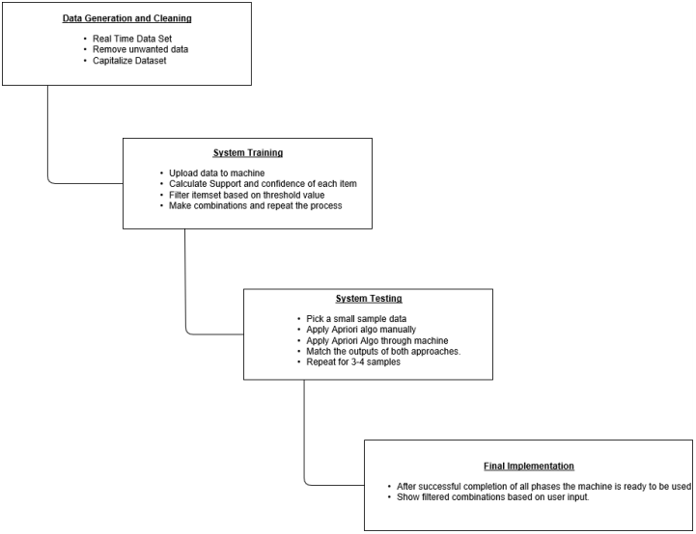
Diagrammatic Representation

Slide 14
System Requirements
Hardware:
  Ram- 4GB
  Processors- Intel Core i3/i5/i7
  HDD- 100GB
Software:
  Operating System- Windows 10/8.1/8/7/XP |Ubuntu
  Programming Language- Procedural Language-C

Slide 15
Schedule(Pert Chart)

Slide 16
References
Documented Reference:
[1] https://www.sciencedirect.com/science/article/pii/S1877050916305208
[3]https://raw.githubusercontent.com/CSIT.../1813_Sanjeev_MarketBasketAnalysis.pdf
Book Reference:
[2] Data Mining-concept and techniques by Jiawei Han, Jian Pei, Micheline Kamber
[4] Data Mining Techniques by Arun k Pujari

Slide 17
The End
Thank You

